Slide 1
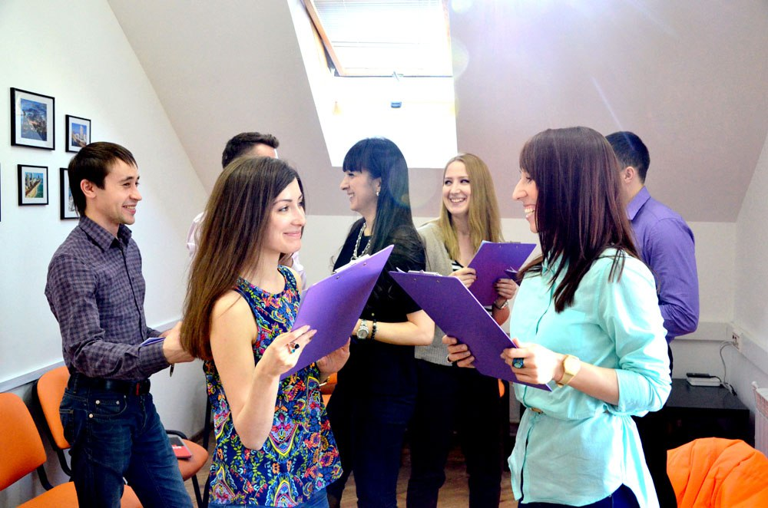
DIALOGUE STATION

Slide 2
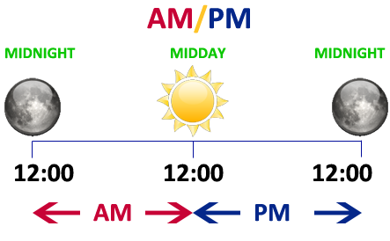
WHAT TIME IS IT?

Slide 3
WHAT TIME IS IT?
Examples:
It’ 9 o’clock a.m.
It’ 1 o’clock p.m.
It’ 6 o’clock p.m.
It’ 2 o’clock a.m.

Slide 4
LETS TALK!
Hello! What time is it?
Hello! It’ 9 o’clock a.m.
Good morning!
Good morning to you!

Slide 6
40-50 - очень хорошо! 30 – 39 - Хорошо!
Video
20- 29- Есть к чему стремиться!
0- 19 - Нужно постараться!

Slide 7
My first name is ……………..
My surname is……………….
I am…(age)…
My nationality is……..
My phone number is…….
My address is………………..
I am a ………………………
I speak English, German, French and Russian
I like (to)…………………………

